Slide 1
Predictive Maintenance Plan for Natura's Production Factory
by Jose Pina
JP

Slide 2
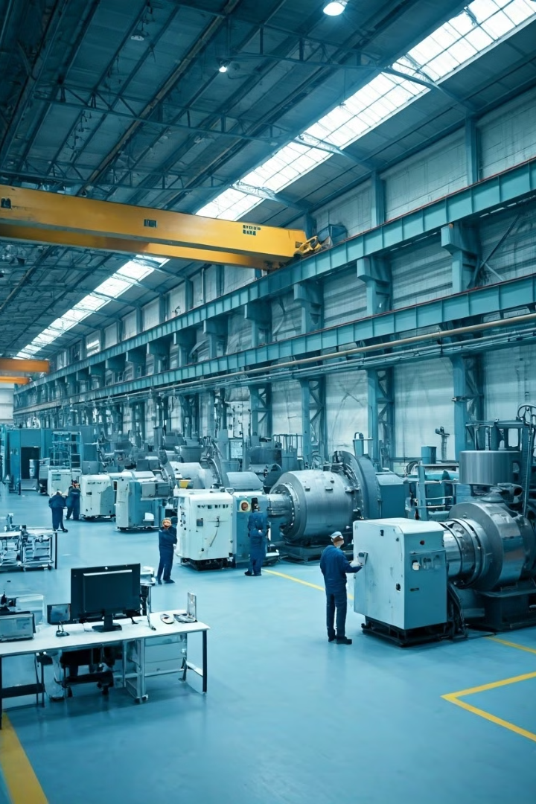
Introduction
1
Predictive Maintenance
This research focuses on the possibility implementing predictive maintenance techniques to enhance the efficiency of Natura's production factory.
2
Data Analysis
The study utilizes historical maintenance data to train machine learning models and predict future equipment failures.
3
Downtime Reduction
The primary objective is to reduce downtime by anticipating failures and implementing proactive maintenance strategies.
4
Operational Efficiency
The research aims to improve operational efficiency by optimizing maintenance schedules and resource allocation.

Slide 3

Context and Justification
Natura's production plant in Buenos Aires is a crucial facility for the company, responsible for a significant portion of its South American market. The plant produces over 400,000 products daily, making downtime a major concern. The plant's importance within Natura & Co's global strategy necessitates minimizing downtime to meet production deadlines and maintain inventory levels.

Slide 4

Relevance
Industry 4.0, characterized by the integration of technologies like artificial intelligence, the Internet of Things (IoT), and data analytics, is transforming manufacturing processes. Predictive maintenance (PdM) is a key component of Industry 4.0, enabling companies to anticipate and prevent failures, minimizing downtime and improving operational efficiency. PdM leverages emerging technologies like IoT, big data, and deep learning to analyze machine data and predict potential failures.

Slide 5

Contribution
Natura currently relies on manual record-keeping and reactive maintenance strategies, which may not fully optimize production efficiency. This research aims to introduce predictive maintenance techniques to Natura's production plant, bringing it closer to the Industry 4.0 philosophy. By applying machine learning models to historical failure logs, the study seeks to predict failures and implement proactive maintenance strategies.

Slide 6


Objectives
General Objective
Specific Objectives
Develop a predictive model based on historical maintenance and performance data to predict future failures in production equipment, reducing downtime, optimizing maintenance times, and improving operational efficiency in the production plant.
Develop a failure prediction model using machine learning techniques.
Optimize spare parts and resource management by integrating the predictive model into inventory and human resources planning.
Optimize the maintenance plan by aligning it with the actual needs of the plant, based on the criticality of the equipment and the predictions of the model.

Slide 7

Literature Review
Maintenance engineering plays a crucial role in optimizing industrial processes. Advancements in big data and machine learning (ML) have enabled proactive failure detection and minimized human intervention in diagnostic processes. Industry 4.0, driven by IIoT, leverages interconnected sensors to generate large volumes of data on physical assets, facilitating automatic learning systems for predictive maintenance decisions.

Slide 8

Machine Learning
Machine learning focuses on creating algorithms and models capable of learning from data, enabling computers to improve their performance on specific tasks without explicit programming. These systems identify patterns in large volumes of data, allowing them to make predictions or decisions based on experience. The two main categories of machine learning methods are supervised learning and unsupervised learning.

Slide 9

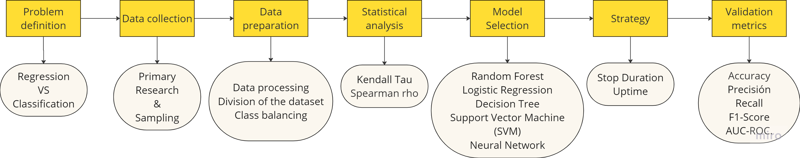
Metodology

Slide 10
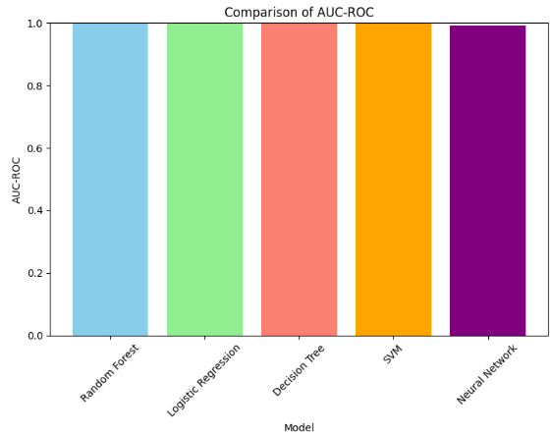
Results of prediction
Stop Duration - balanced
Uptime - balanced
Model | Accuracy | Precision | Recall | F1-Score | AUC-ROC
Random Forest | 1,00 | 1,00 | 1,00 | 1,00 | 1,00
Logistic Regression | 0,99 | 0,94 | 0,99 | 0,96 | 1,00
Decision Tree | 1,00 | 1,00 | 1,00 | 1,00 | 1,00
SVM | 0,98 | 0,88 | 1,00 | 0,94 | 1,00
Neural Network | 0,97 | 0,79 | 1,00 | 0,88 | 0,99
Model | Accuracy | Precision | Recall | F1-Score | AUC-ROC
Random Forest | 0,899 | 0,551 | 0,778 | 0,645 | 0,923
Logistic Regression | 0,917 | 0,698 | 0,524 | 0,599 | 0,748
Decision Tree | 0,899 | 0,551 | 0,778 | 0,645 | 0,924
SVM | 0,917 | 0,698 | 0,524 | 0,599 | 0,745
Neural Network | 0,896 | 0,543 | 0,778 | 0,640 | 0,858

Slide 11

Conclusion
The research findings demonstrate the effectiveness of predictive maintenance techniques in improving production efficiency and reducing downtime. The analysis of failure duration data yielded highly accurate predictions, highlighting the potential of machine learning models to anticipate equipment failures. The results suggest that prediction based on failure duration is a more robust approach than prediction based on uptime, particularly in the context of Natura's production plant.

